Slide 1


Slide 2
INTERNET
Team: Dcoding
Presented by: Muzammal Hussain & Kashif

Slide 3
INTERNET
Introduction to the Internet
History of the Internet
Uses of the Internet
Benefits of the Internet
Disadvantages of the Internet
The Future of the Internet

Slide 4
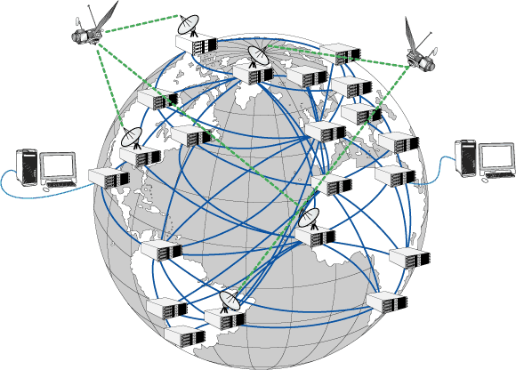
Introduction to the Internet
The internet is a global network connecting millions of computers.
It allows users to share information and communicate worldwide.
It has transformed how we work, learn, and interact.

Slide 5

History of the Internet
1960s: Concept introduced by the U.S. Department of Defense (ARPANET).
1980s: Development of the World Wide Web (WWW) by Tim Berners-Lee.
1990s-Present: Rapid expansion and commercialization of the internet.

Slide 6
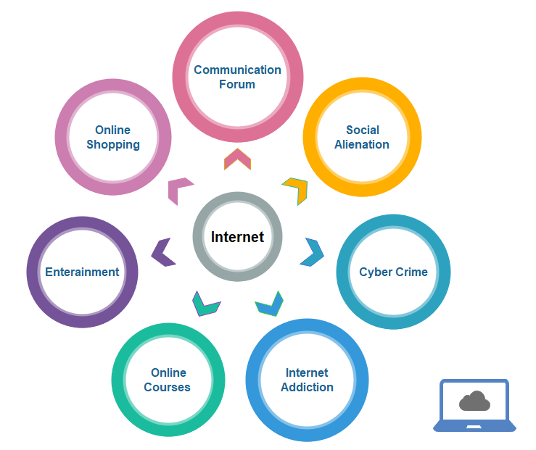
Uses of the Internet
Communication: Emails, social media, video calls.
Education: Online courses, research, e-books.
Entertainment: Streaming, gaming, social media.
E-Commerce: Online shopping, banking, business transactions.

Slide 7

Benefits of the Internet
Global Connectivity: Instant access to information.
Convenience: Work and study from anywhere.
Economic Growth: Boosts businesses and job opportunities.
Knowledge Sharing: Easy access to educational resources.

Slide 8

Disadvantages of the Internet
Cybersecurity Threats: Hacking, identity theft, malware.
Misinformation: Spread of fake news and false data.
Privacy Issues: Data tracking and online surveillance.
Addiction & Mental Health: Excessive social media usage.

Slide 9
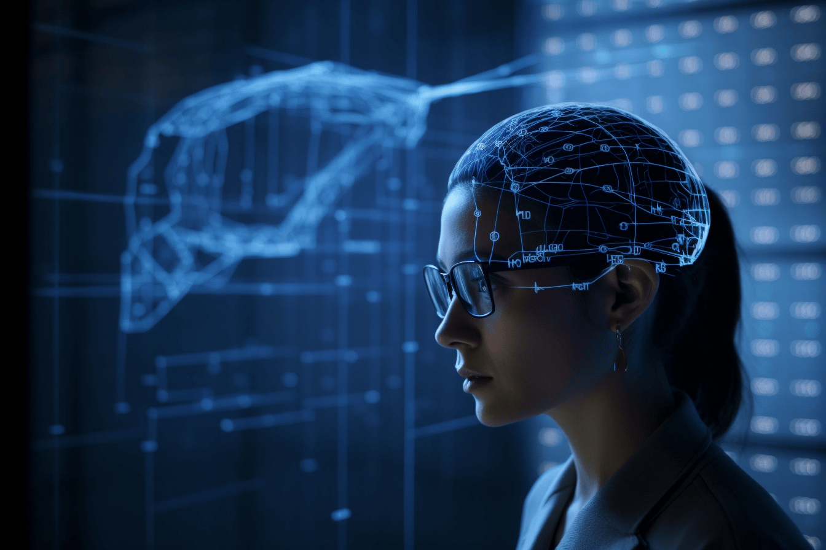
The Future of the Internet
5G and Faster Connectivity.
Artificial Intelligence (AI) Integration.
Smart Cities and IoT (Internet of Things).
Blockchain and Decentralized Internet.

Slide 10


Slide 11


